Slide 1
Internet of Things: Oppositions and Applications
PhD Scholar, Faculty of Management Science, Amity University
Abhimanyu Ahluwalia
PhD Scholar, Faculty of Management Science, Amity University

Slide 2
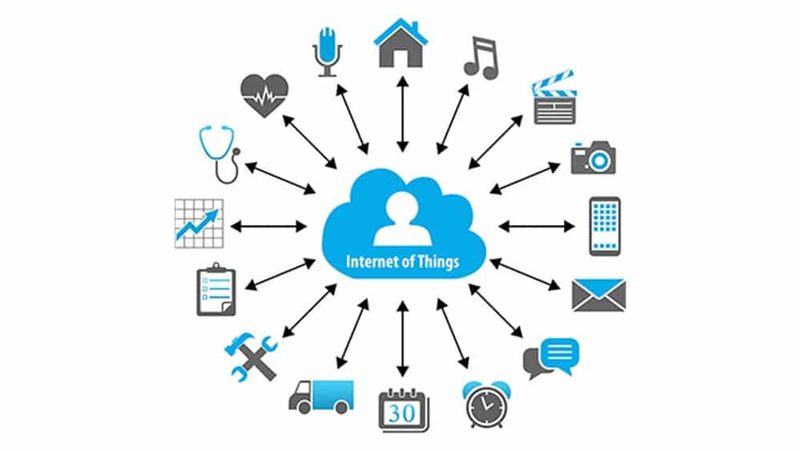
Internet & IoT
The Internet can be described as the communication network that connects people to information, while the Internet of Things (IoT) is a networked system of differently addressable physical objects with varying degrees of processing capacity , detection and operation that the ability to interoperate and communicate over the Internet as a common platform

Slide 3
Internet Of Things
As the Internet of Things (IoT) gradually evolves as the later phase in the evolution of the Internet , it becomes critical to understand the various potential applications of IoT and the research challenges associated with those applications. From Smart Cities to Healthcare, Smart Agriculture, Logistics and Retailing to Smart Living and Smart Environments, IoT is expected to invade virtually every aspect of daily life. Although the current IoT technologies enabling have improved a lot in recent years, there are still numerous issues that require attention.
IoT is paving the way for new dimensions in research. This document presents the recent development of IoT technologies and discusses future applications and research challenges.

Slide 4
POSSIBLE AREAS OF APPLICATION OF IOT
Smart cities
According to the IoT plays a crucial role in improving the intelligence of cities and improving the general infrastructure.
Some of the uses of IoT in creating smart cities include;
smart traffic systems
smart buildings,
traffic jams
waste management
smart lighting
smart parking lots and city maps.
This may include various functions such as: Monitoring of available parking within the city, monitoring of vibrations and the physical condition of bridges and buildings, installation of sound monitoring devices at sensitive points in the city and monitoring of the pedestrian and vehicle level

Slide 5
Medical Care
Many of the benefits that IoT applications offer in healthcare can best be classified as patient, staff, and object tracking, person identification and authentication and automatic data and sensor collection.
Hospital workflow can be greatly improved once the flow of patients is tracked. In addition, authentication and identification reduce incidents that can be harmful to patients, maintain maintenance records and less mismatched baby incidents
Sensor devices enable patient-centric functions, especially when diagnosing diseases and providing real-time information on the health indicators of patients
Other elements of the IoT in this function are: RFID, Bluetooth and WiFi among others.
These will greatly improve the techniques for measuring and monitoring critical functions such as blood pressure, temperature, heart rate, blood sugar, cholesterol levels, and many others.

Slide 6
Smart Agriculture and Water Management
IoT would make it possible to control and preserve the number of vitamins in agricultural products and regulate the microclimate conditions to make the most of the production of fruits and vegetables and their quality.
When it comes to livestock, the IoT can help identify animals that graze in open spaces, detect harmful gases from animal excrement on farms and monitor growth conditions in offspring to improve health and chances of survival , etc.
IoT in agriculture can avoid a great deal of waste and spoilage through proper monitoring techniques and management of the entire agricultural area.
IoT includes studying the suitability of water in the seas and rivers for both drinking and agriculture, detecting pressure fluctuations in pipes and the presence of liquids outside the tanks to monitor variations of water in dams, rivers and reservoirs.

Slide 7
Retail and logistics
IoT in the supply chain or retail management has many advantages.
Some include:
Compliance with storage conditions throughout the supply chain,
product monitoring to allow traceability
payment processing according to location or period of activity in public transport amusement parks, gyms and others.
In stores, IoT can be applied to various applications , such as in-store guidance based on a pre-selection list , fast checkout processes such as automatic check-out using biometrics, detection of potential allergen products and the control of product rotation in shelves and warehouses to automate replenishment procedures
IoT helps detect gas concentrations and leaks within and around industry and tracks toxic gases and oxygen levels within the boundaries of chemical plants to ensure the safety of goods and workers and oil observation -, gas and water levels in tanks and storage tanks.
The use of IoT also helps with maintenance and repair , as systems can be configured to predict device failures while automatically scheduling regular maintenance services before devices fail.

Slide 8
IoT can be applied in remote control devices whereby one can remotely switch appliances on and off hence preventing accidents as well as saving energy. Other smart home appliances include refrigerators fitted with LCD (Liquid Crystal Display) screens, enabling one to know what is available inside, what has over stayed and is almost expiring as well as what needs to be restocked. This information can also be linked to a smartphone application enabling one to access it when outside the house washing machines can allow one to remotely monitor laundry. In addition, a wide range of kitchen devices can be interfaced through a smartphone, hence making it possible to adjust temperature, like in the case of an oven. In terms of safety in the home, IoT can be applied through alarm systems and cameras can be installed to monitor and detect window or door openings hence preventing intruders
Smart Living

Slide 9
RESEARCH CHALLENGES

Slide 10
Privacy and Security
Various attacks and weaknesses on IoT systems prove that there is indeed a need for wide ranging security designs which will protect data and systems from end to end.
This security gap further motivates comprehensive security solutions that consist of research that is efficient in applied cryptography for data and system security, noncryptographic security techniques as well as frameworks that assist developers to come up with safe systems on devices that are heterogeneous.
Additional areas like confidentiality in communication, trustworthiness, and authenticity of communication parties, and message integrity, and supplementary safety requirements should also be incorporated in IoT.

Slide 11
Data Processing, Analysis and Management
There is a constant concern that traditional cloud architectures are ineffective, transfer the huge amounts of data generated and consumed by IoT-enabled devices.
Once collected, the data must be used intelligently to achieve intelligent IoT functions.
The development of machine learning methods and artificial intelligence algorithms resulting from neural work, genetic algorithms, evolutionary algorithms and many other artificial intelligence systems is essential to achieve automated decision making

Slide 12
Monitoring and Sensing
Technologies related to monitoring and sensing have made enormous progress, they are constantly evolving with a particular focus on energy efficiency and the appearance of form.
Sensors and tags would normally have to be constantly active to obtain instant data, this aspect makes it essential for energy efficiency, especially in extending the useful life of the devices
At the same time, new advances in nanotechnology / biotechnology and in miniaturization of the have allowed the development of nano-scale sensors and actuators.

Slide 13
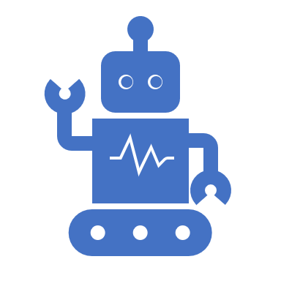
Communication Protocols M2M (Machine-to-Machine)
There is still no standard for an open IoT. Although all objects require connectivity, it is not necessary for every object to be Internet compatible, as they only need to have some capacity to put their data on a particular gateway.
It is unclear whether the available wireless technologies have the ability to continue to cover the broad range of IoT connectivity.

Slide 14
Interoperability
The initial prerequisite in Internet connectivity necessitates that “connected” systems have the ability to “speak a similar language” in terms of encodings and protocols.
Due to the large quantities and types of data, as well as heterogeneous devices, using standard interfaces in such diverse entities is very important and even more significant for applications which support cross organizational, in addition to a wide range of system limitations.

Slide 15
Questions

Slide 16
Thank You

